Slide 1
Flower Power Plant Staycation
Automated Watering and Lighting System for Indoor Plants
By: Brynn, Lauren, and Jilly!

Slide 2
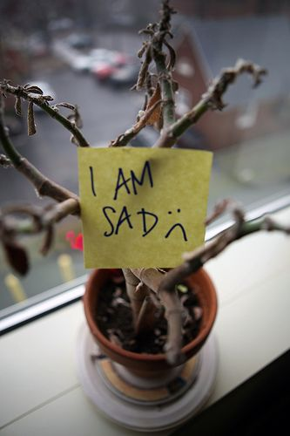
Have you ever wanted to keep plants but have been too busy doing circuits projects to remember to water them???
WELL LOOK NO FURTHER!
We designed a fully automated watering and light system so you can keep your plants alive from the comfort of a mobile app!

Slide 3
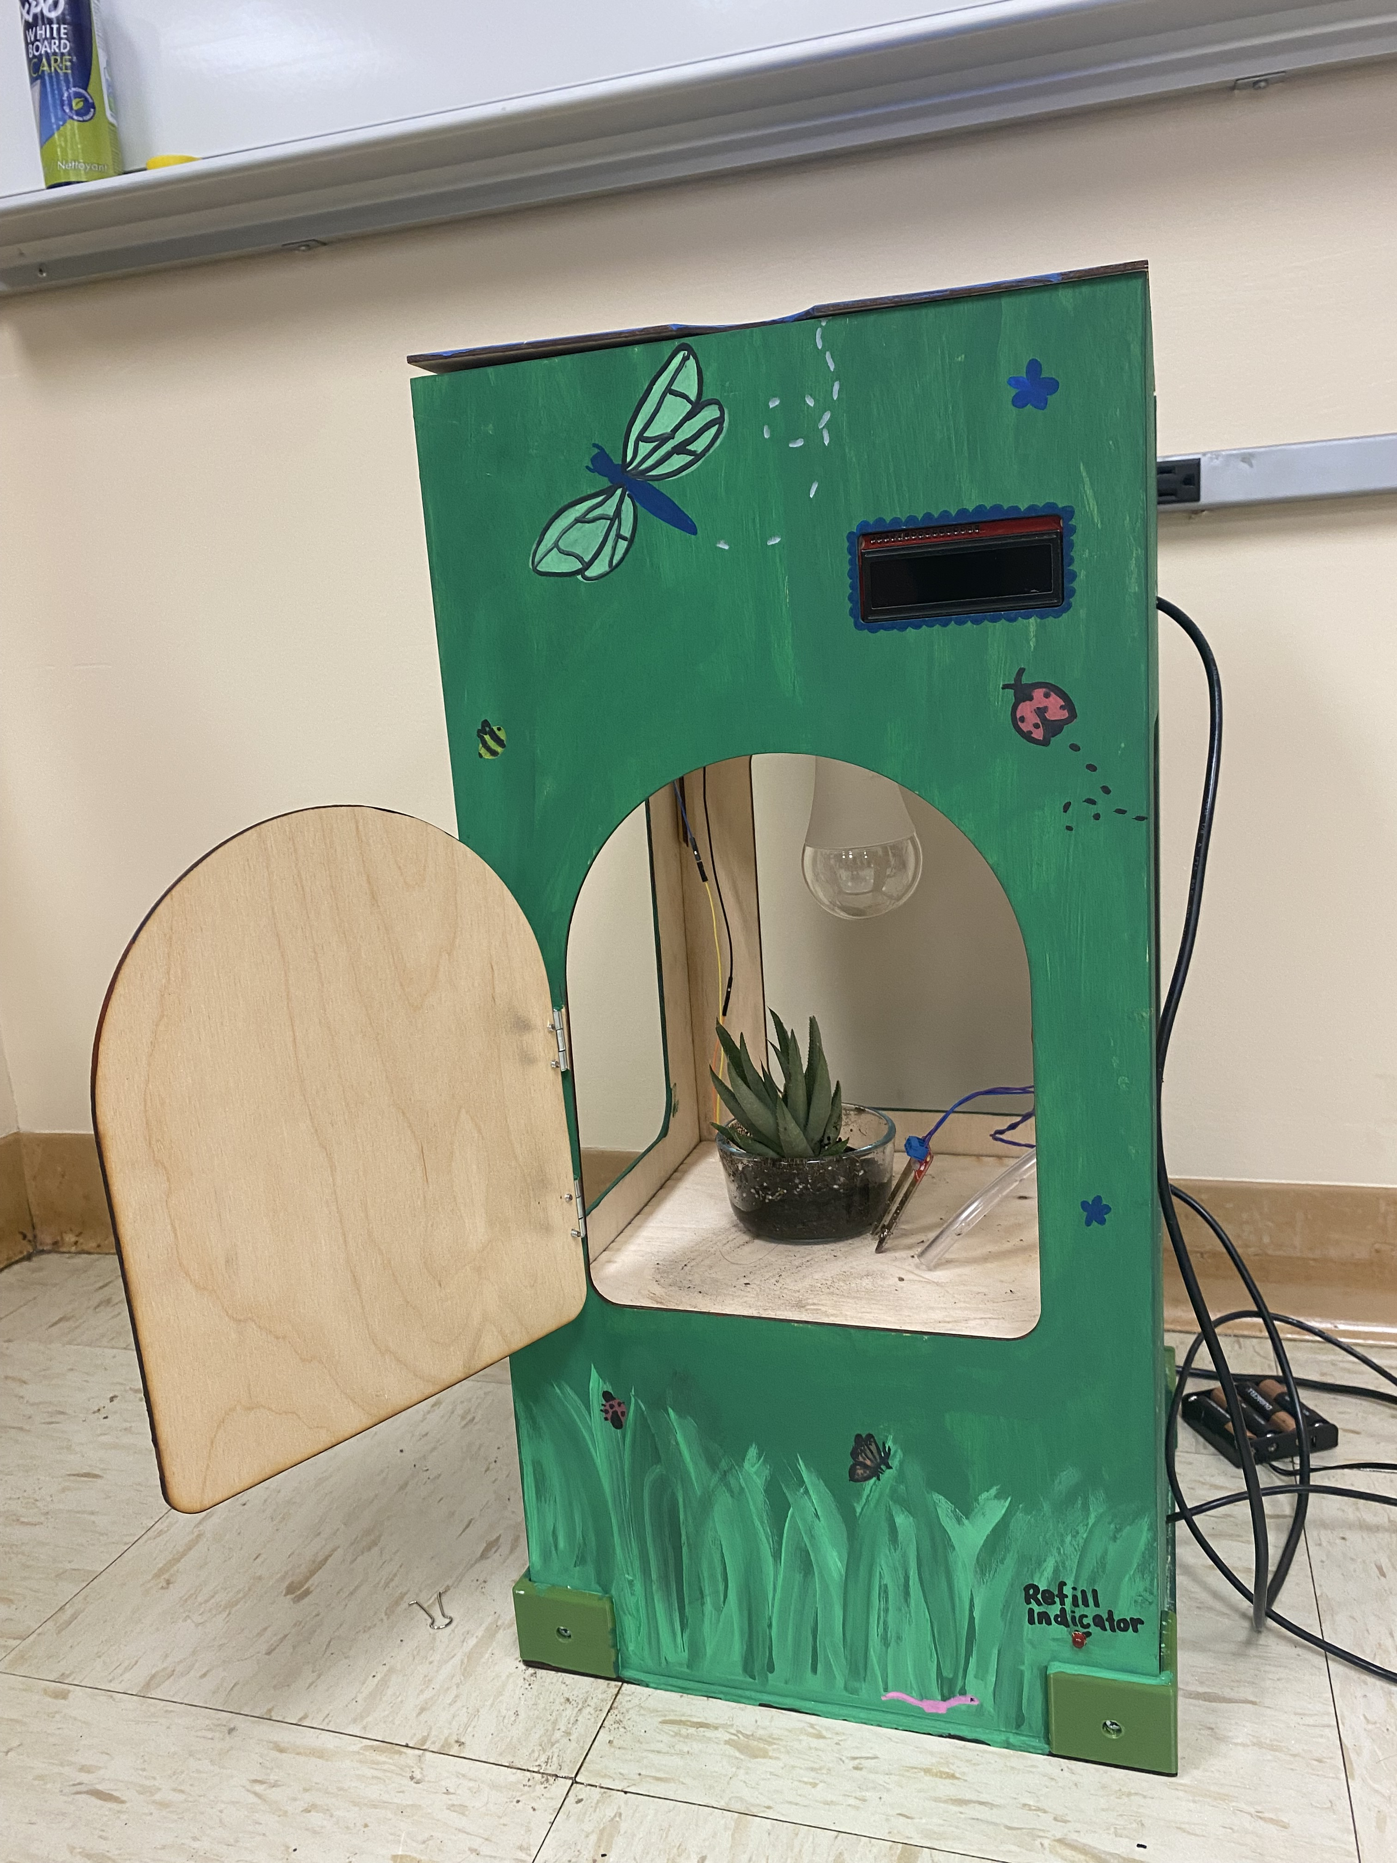
Flower Power Staycation
pic of box**
Box Features
Waters plants based on how dry the soil is
Customizable lighting schedule based on real time
Water reservoir with indicator to refill when water is low
LCD Screen to display values

Slide 4
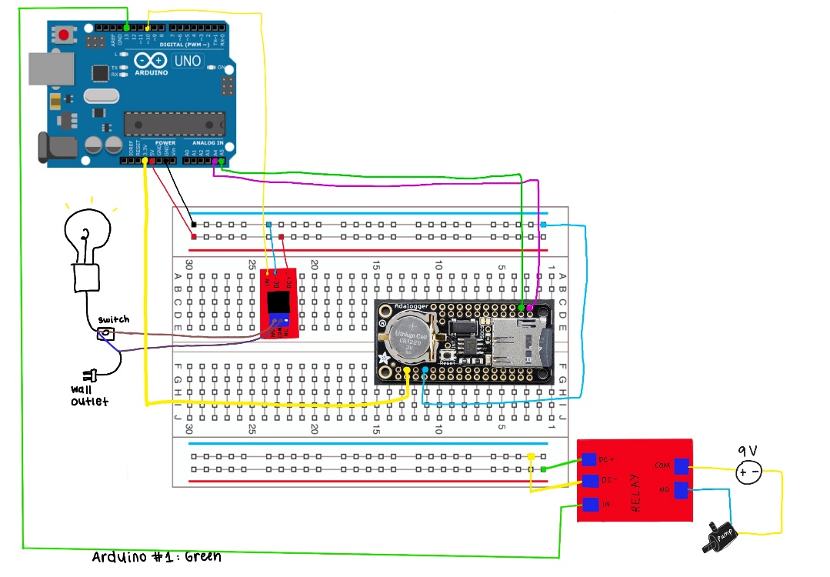

Slide 5
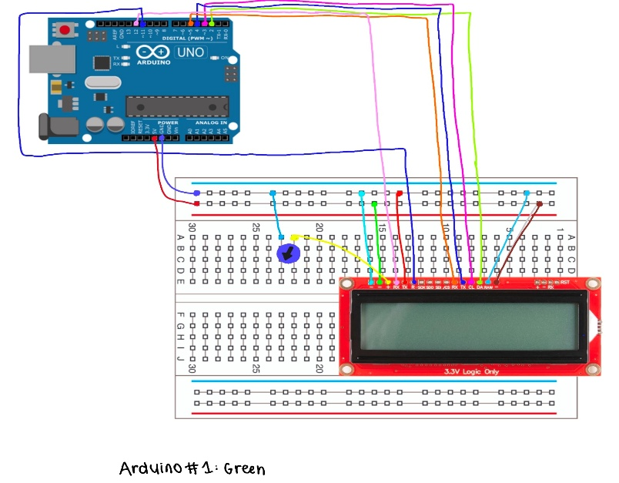

Slide 6
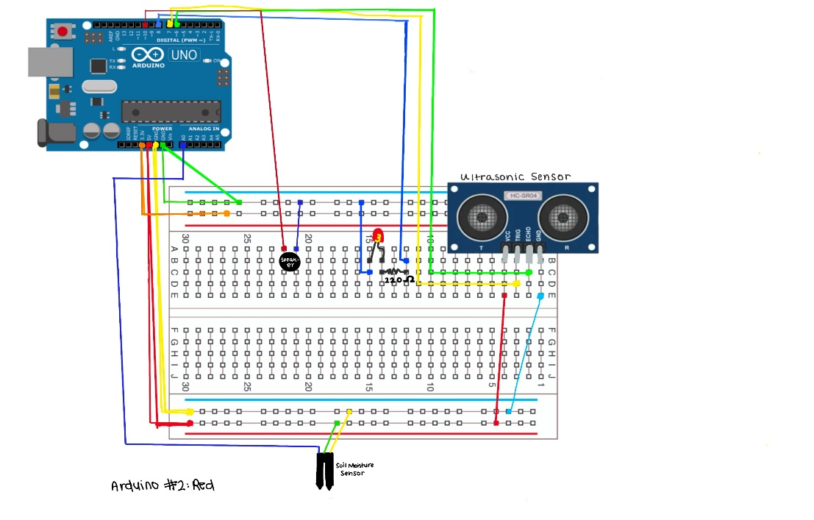

Slide 7
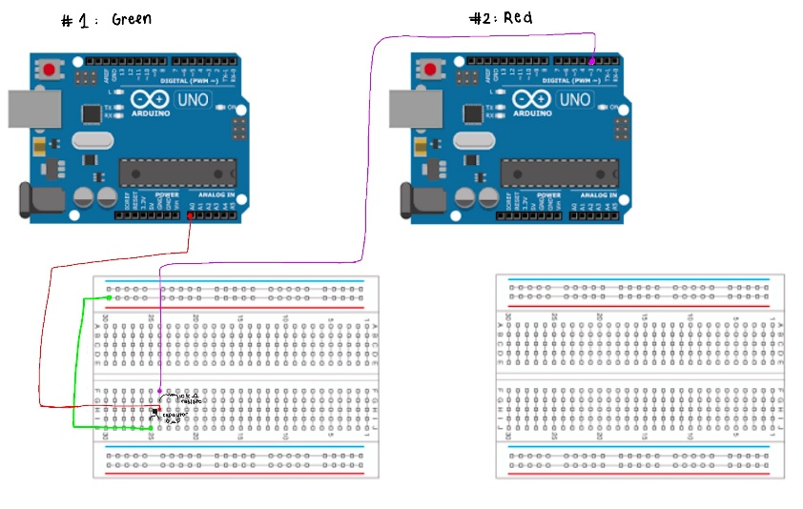

Slide 8
Mobile App
WOW! SO COOL!

Slide 9
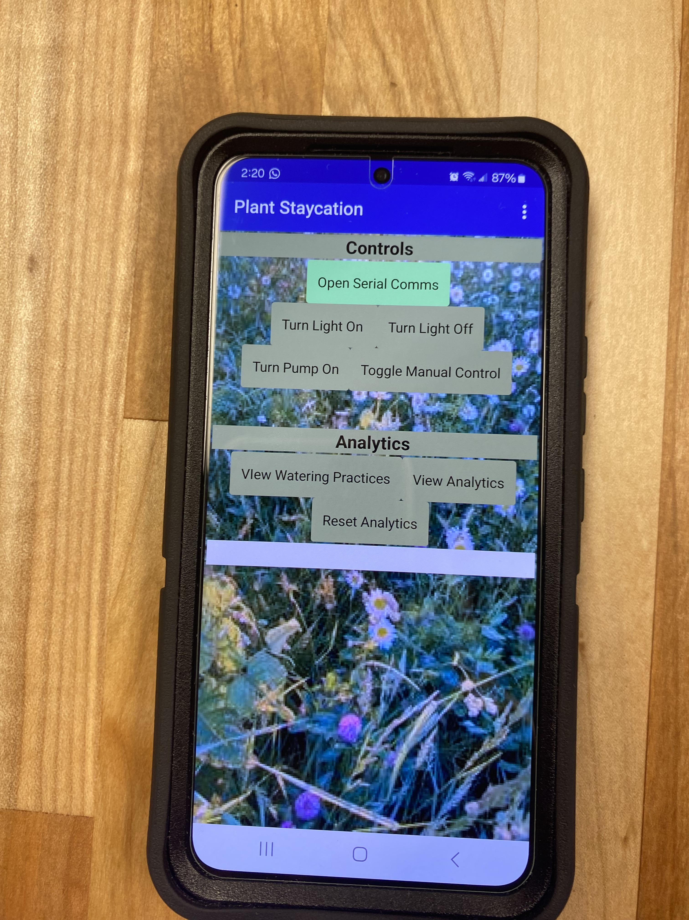
Mobile App
Designed a mobile app so the user can customize lighting schedule and more on the go!
App Features
Can turn the light on and off
Can turn the motor on and off!
Showcases Plant Health Trends
Gives examples on when to water / light based on the plant
**pic of app

Slide 10
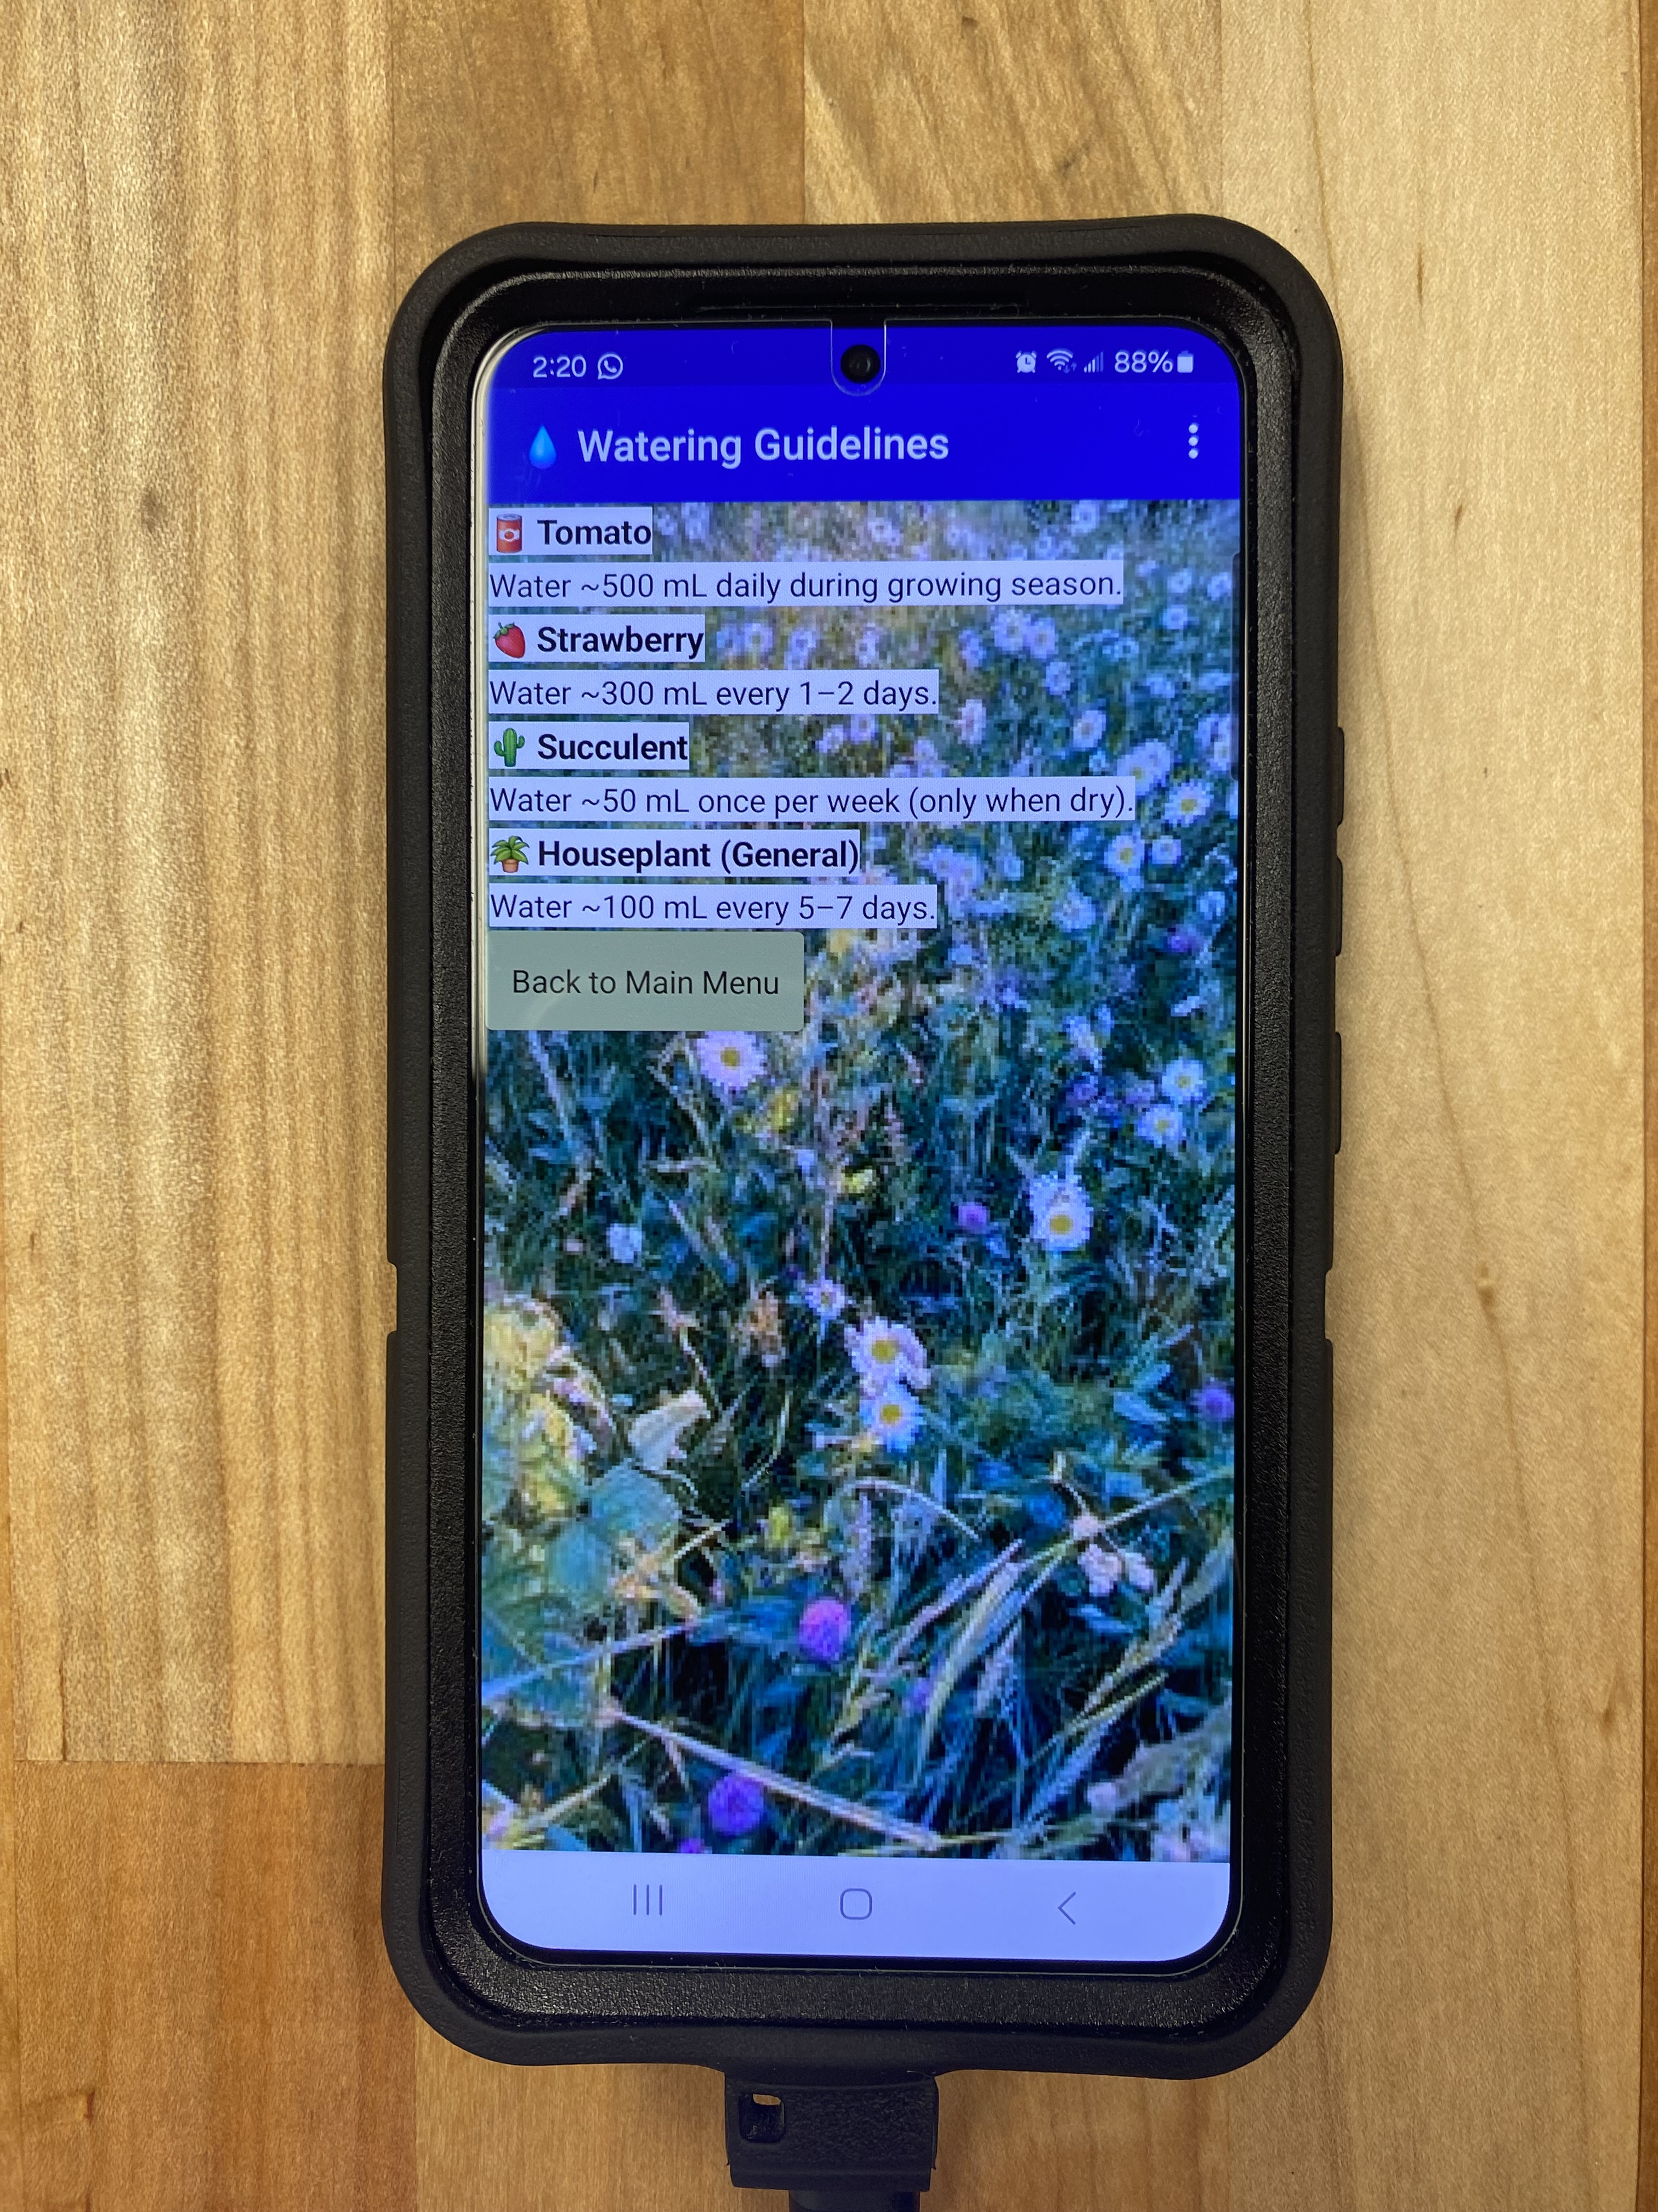
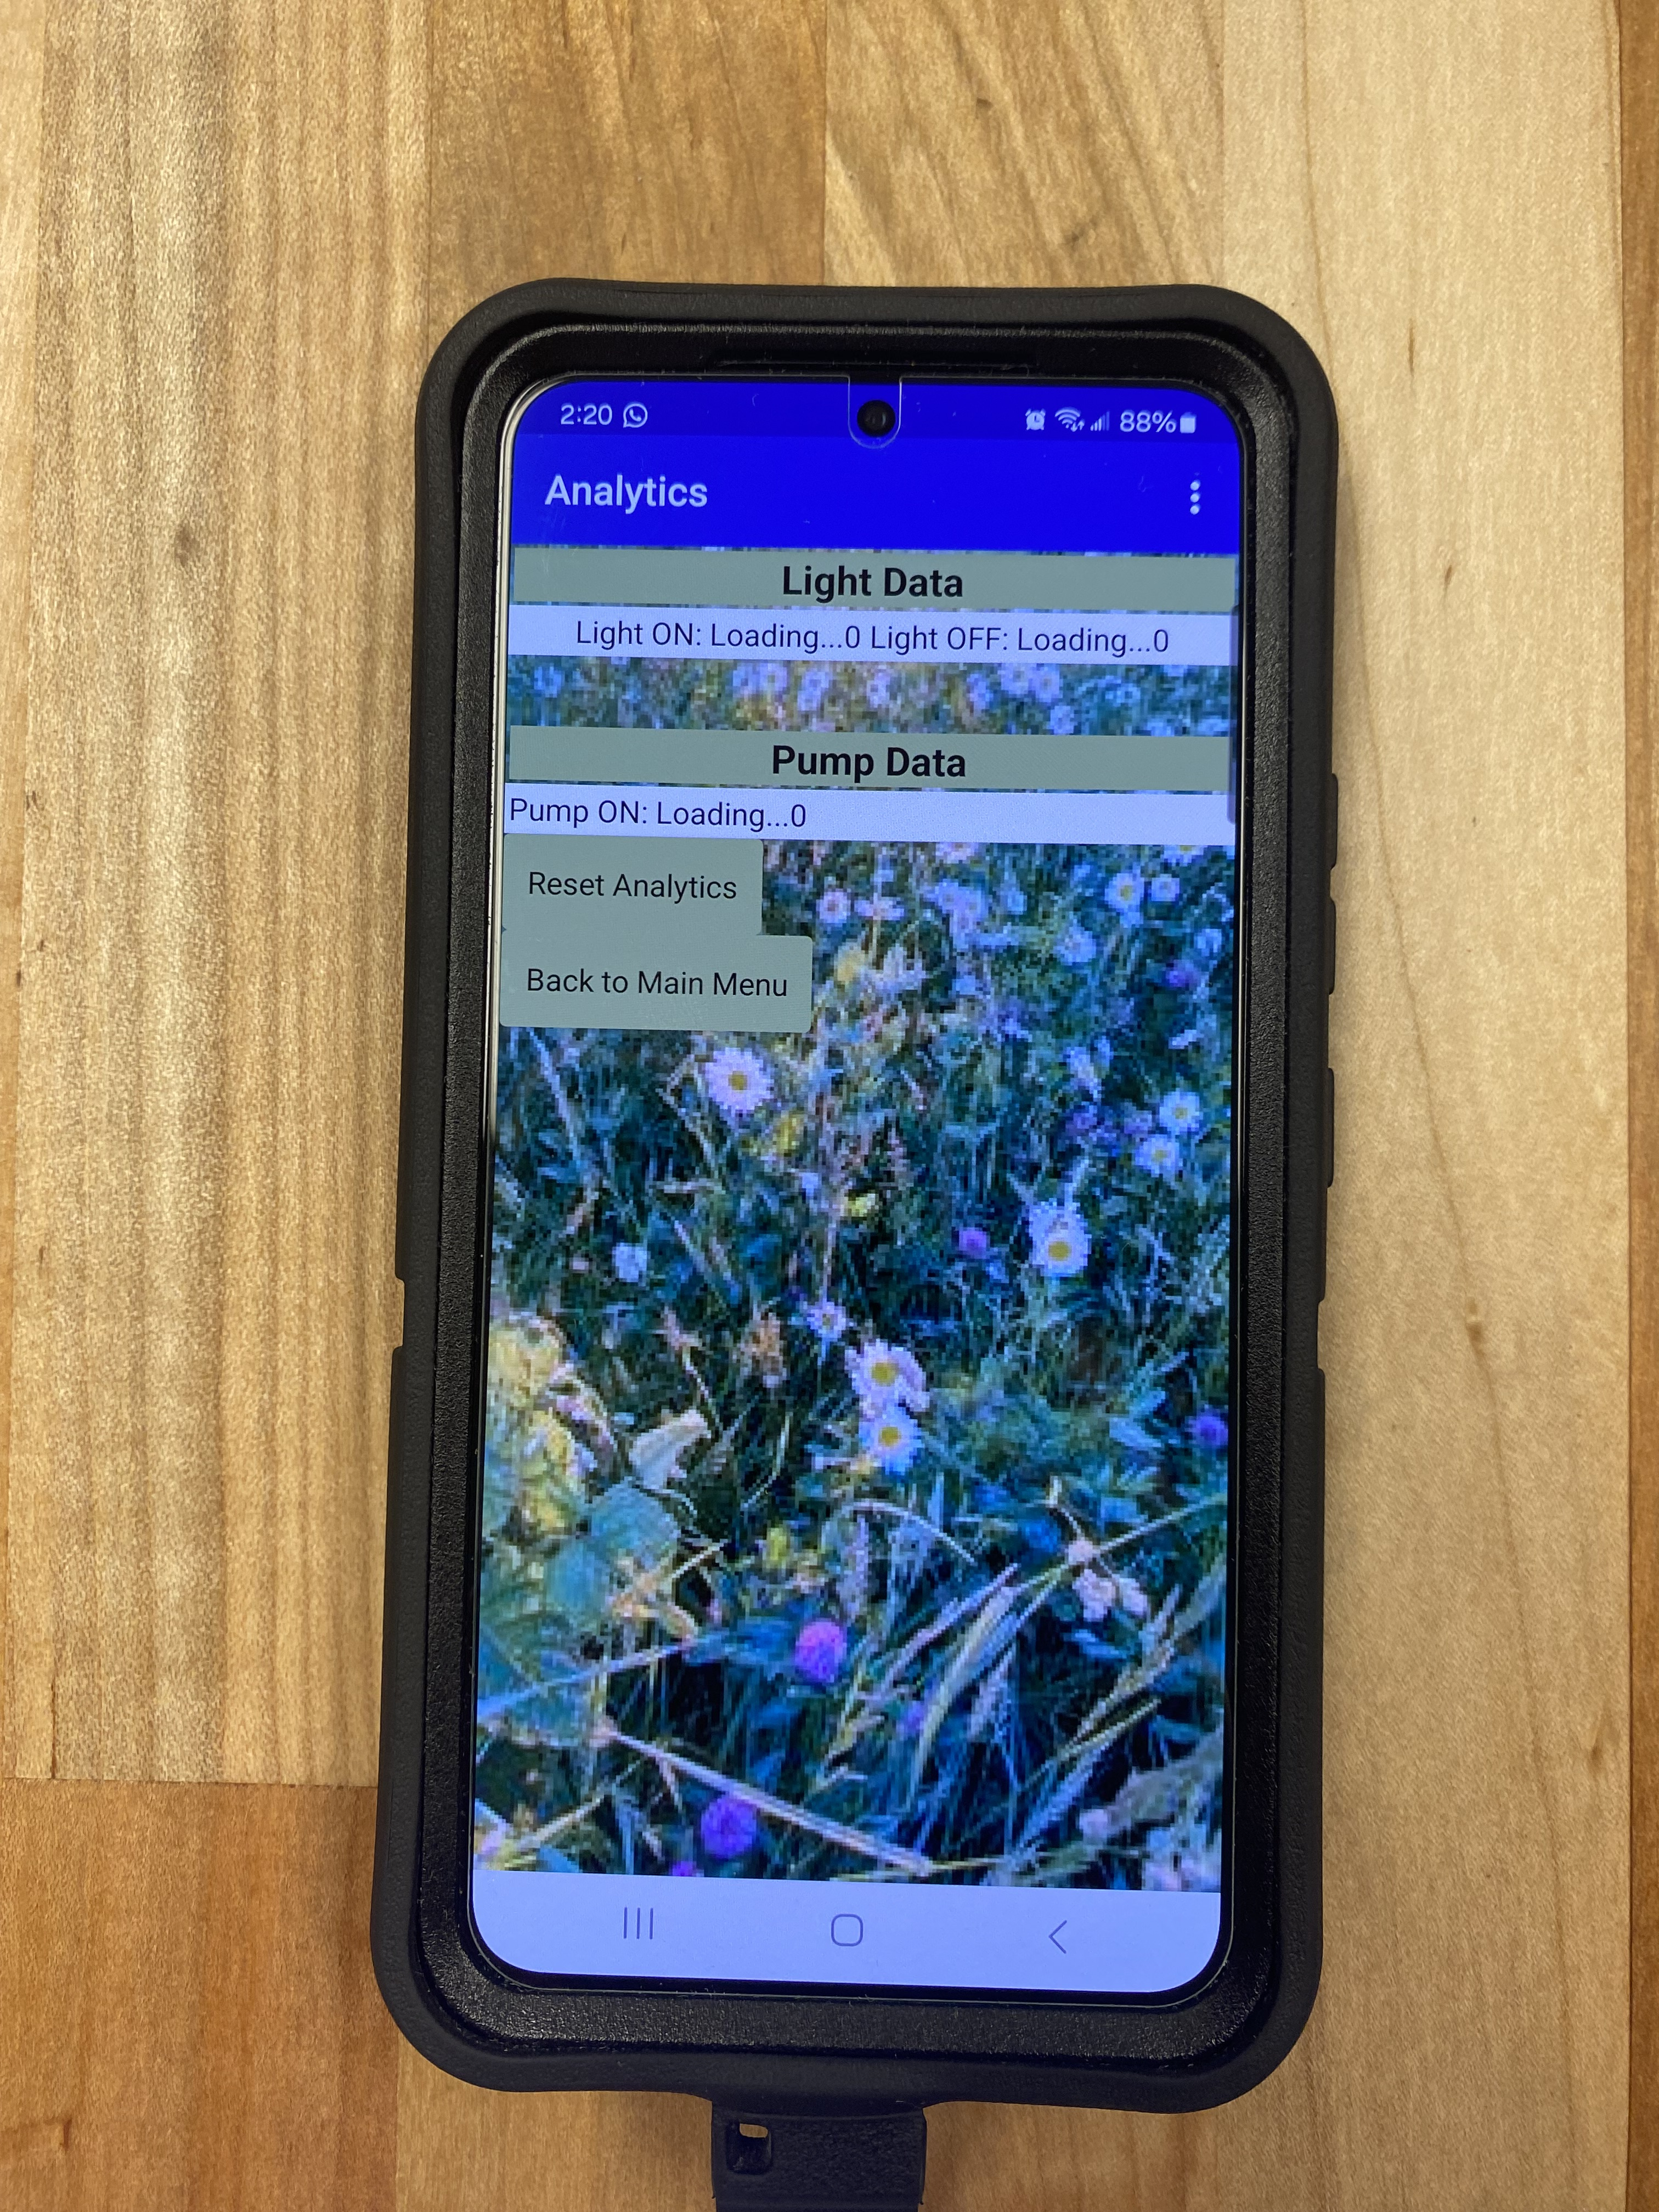

Slide 11
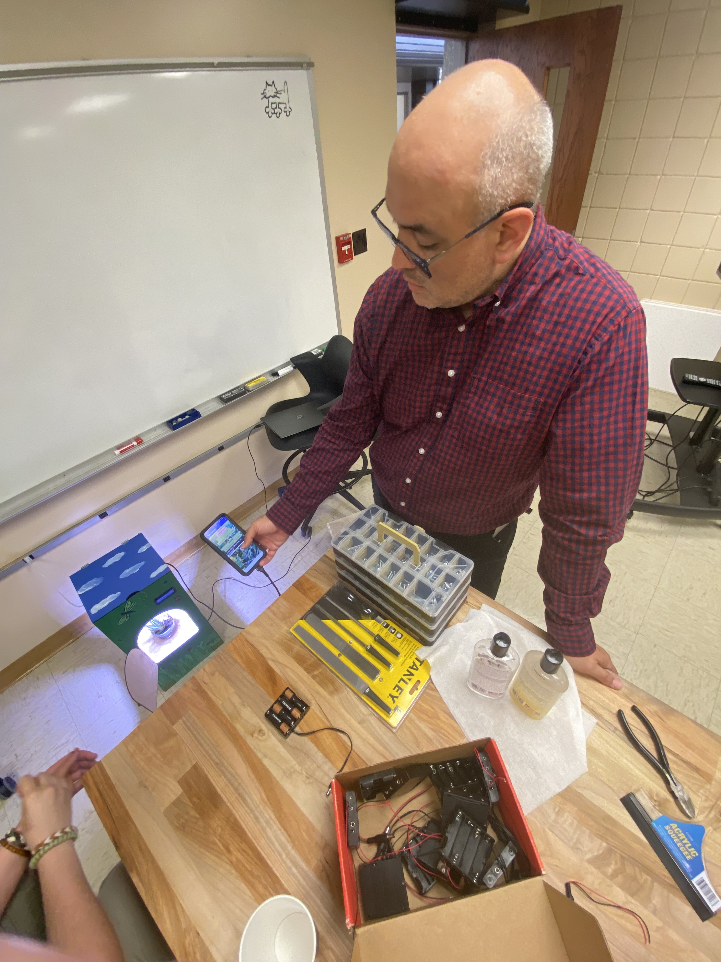
Our first customer loves it!!
**Pic of Dr. Jarro on the app

Slide 12
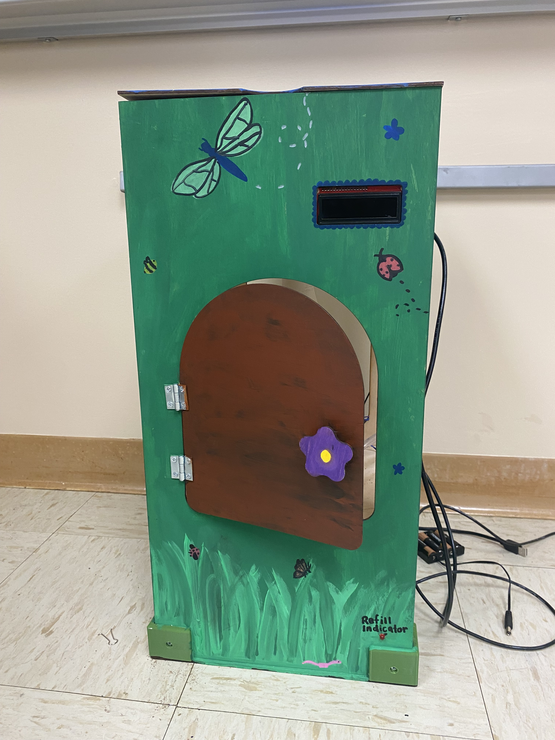
Where does this product work best?
Another pic of the box**
* This product works in indoor spaces like a dorm, office, or apartment.
* It does not need a direct light source to work
* Needs a wall plug and flat surface

Slide 13
Video:
https://youtube.com/shorts/TUuvGFP_XyI?si=8zHP-DmhiAAx6r7f

Slide 14

Thank you!!! ☺

